Slide 1




Slide 2

What is the average league’s wages in the top five leagues?

Slide 3
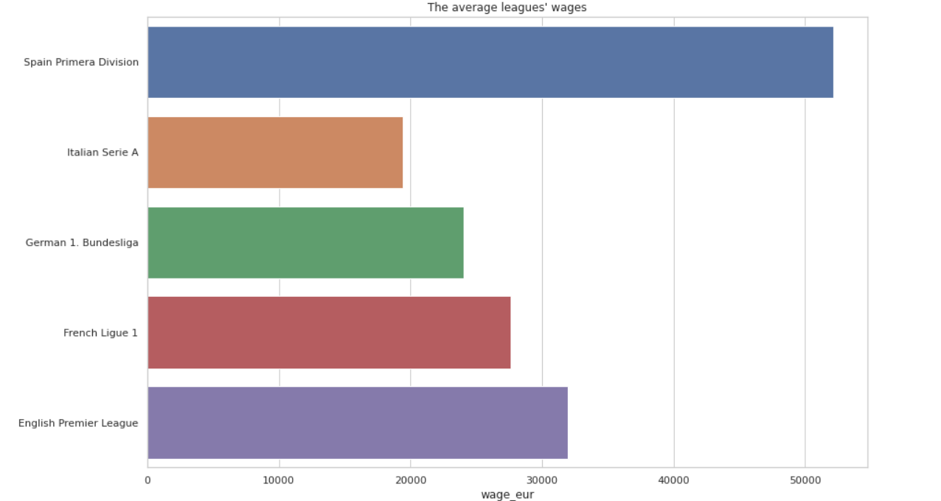
My Insights:
Highest wages are in Spanish league then England, France, Germany and Italy respectively.

Slide 4

What are the reasons of the huge variety in wages among players?

Slide 5
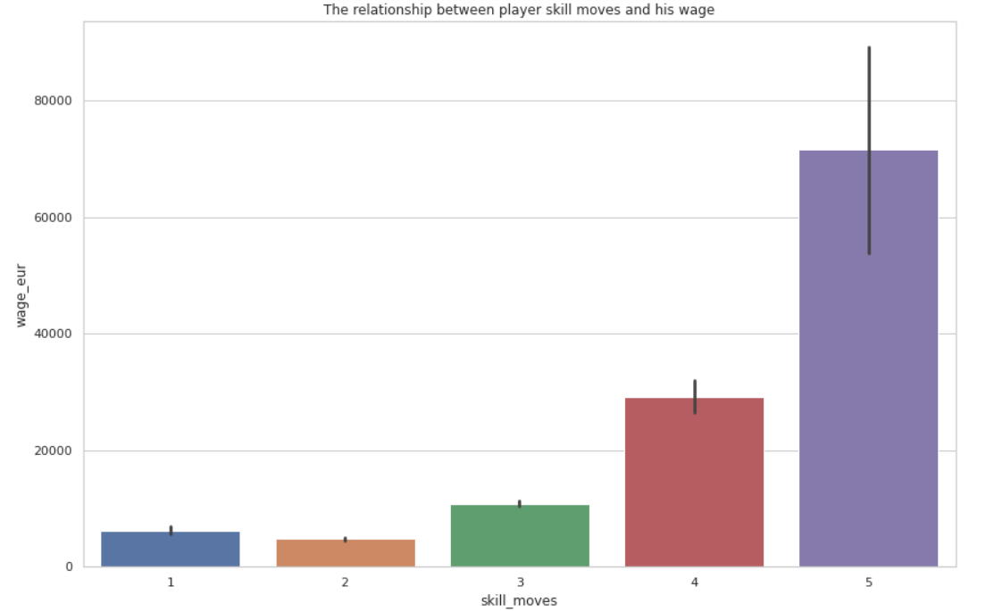
My Insights:
The more players are skillful and have the ability to penetrate opponents’ defenses , the more they are get paid.

Slide 6
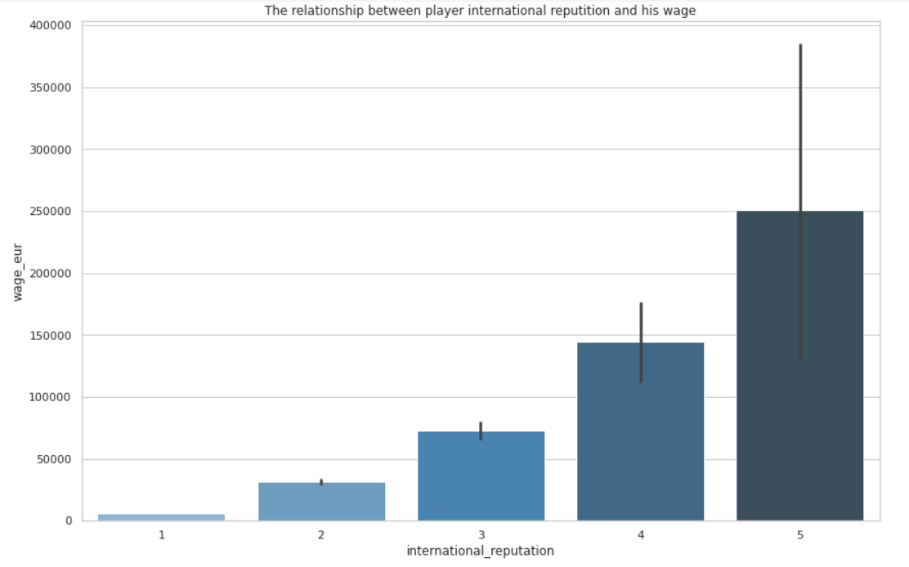
My Insights:
The more players are experienced with their home countries and have a good reputation, the more they are get paid.

Slide 7
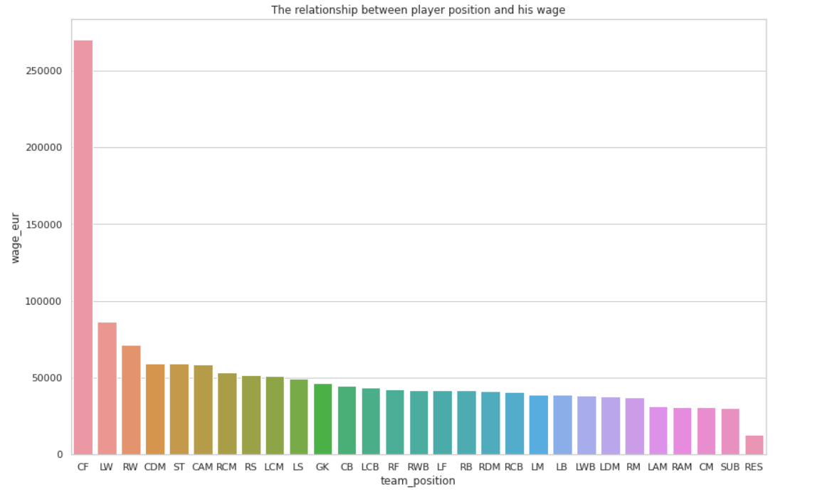
My Insights:
Players who take responsibility to score goals and always under the pressure of scoring goals or creating chances are rewarded with more wages than their peers.

Slide 8

Which leagues depend the most on foreigners?

Slide 9
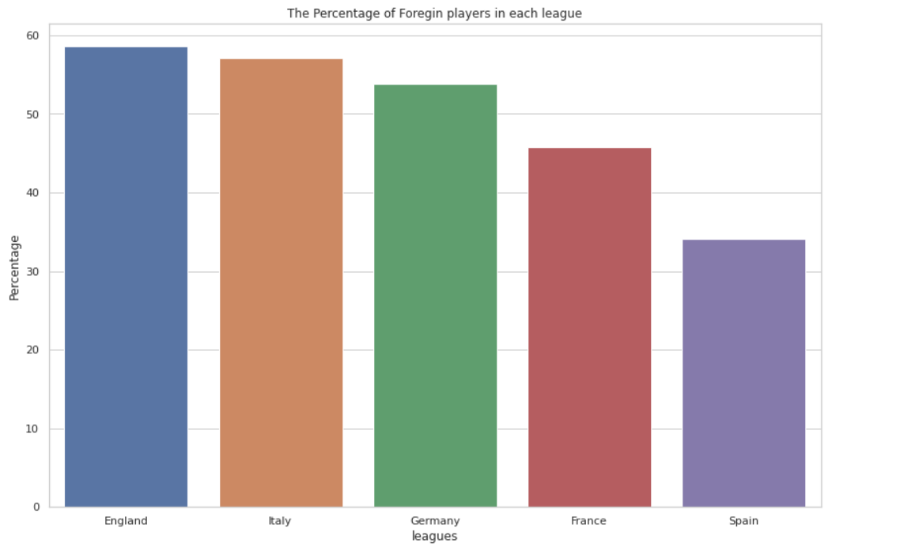
My Insights:
The English league is the most league in the world which depends on foreign players then Italy, Germany, France and Spain respevtively.

Slide 10

What is the age rate in each league?

Slide 11
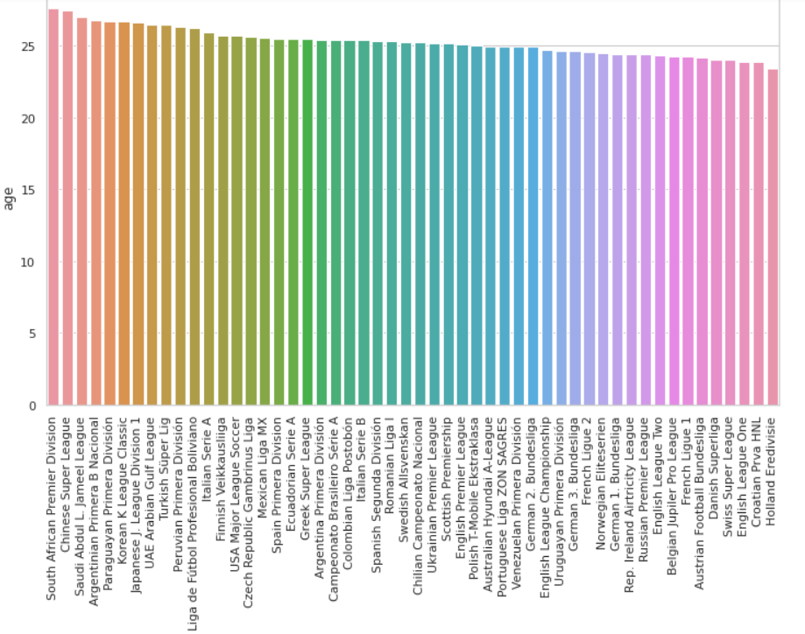
My Insights:
Age rate in professional and European leagues are lower than amateur leagues.
Also, the top five leagues depends more on youth players.

Slide 12

What is the number of players according to their preferred foot and Who is more skillful?

Slide 13
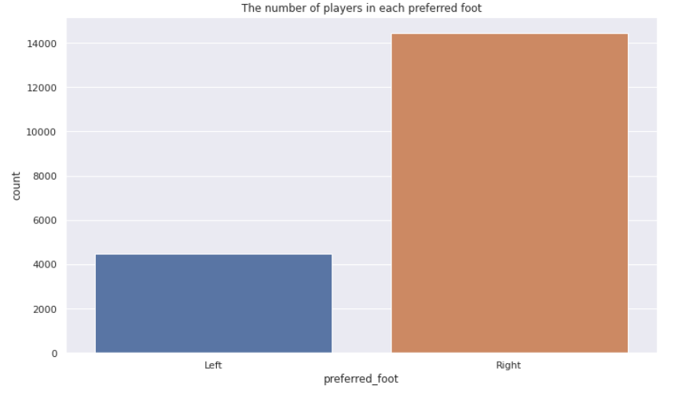
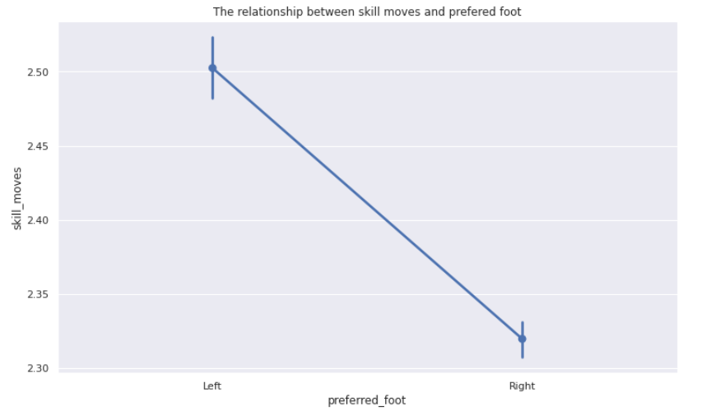
My Insights:
In figure one it is clear that left foot players are rare compared to right footers.
Although left footers are less in number, but it is obvious they are much skillful.

Slide 14

What is the relationship among players position, their vision in the pitch and their skill moves?

Slide 15
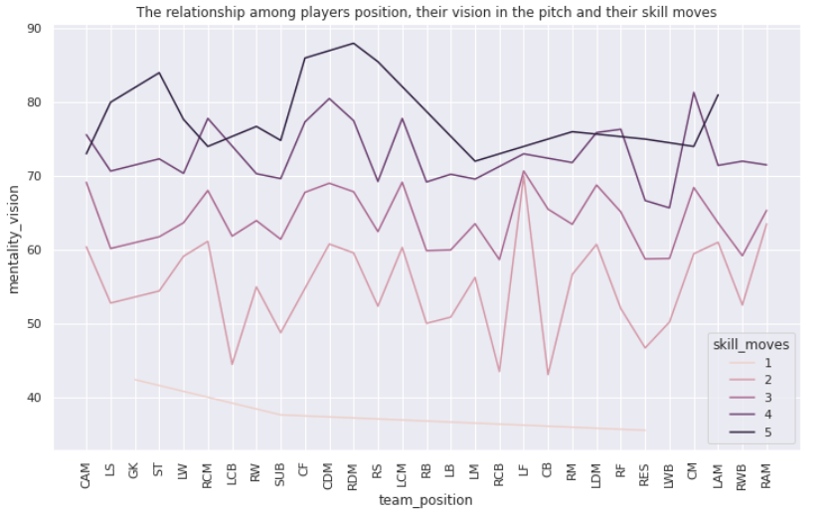
My Insights:
1- Skillful players have higher mentality vision on the pitch.
2- Positions that need a high mentality vision are the midfielders.

Slide 16

What are the validity of contracts in the clubs?

Slide 17
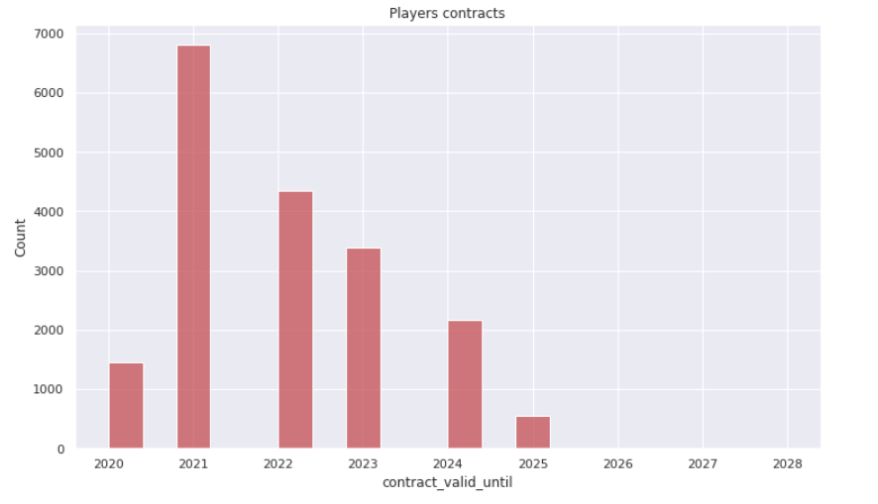
My Insights:
No insight just a helpful histogram.

Slide 18
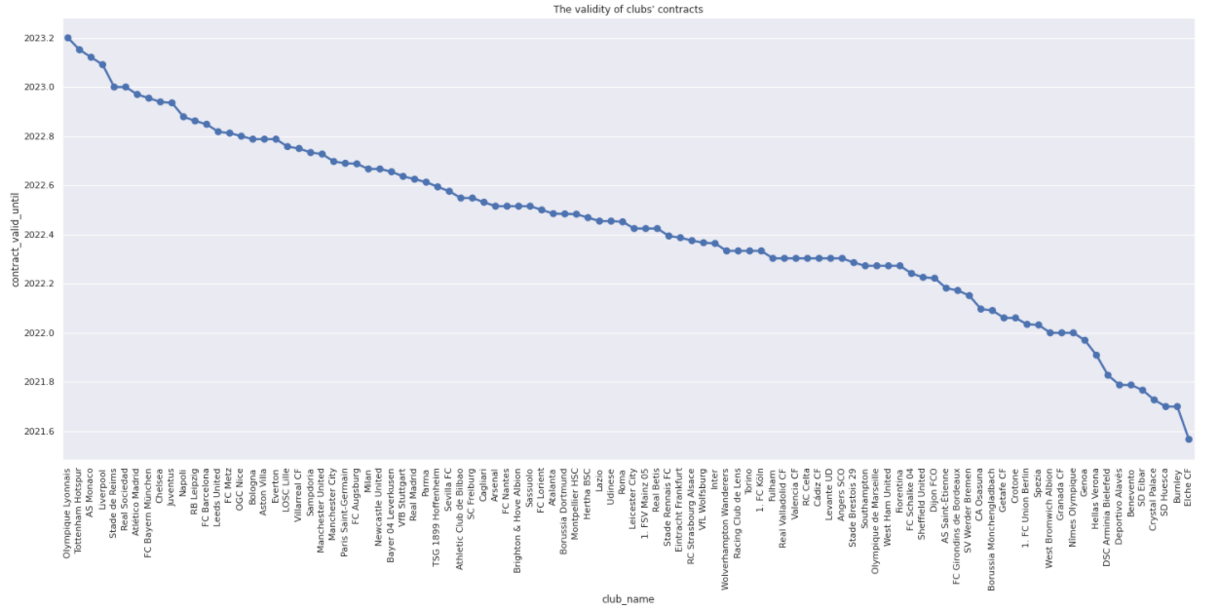
My Insights:
We can conclude the players contract validity.
This graph can really help teams' managers to know if they are in a dangerous zone due to expired contracts or not.

Slide 19

كفاية تساؤلات بقا دماغاااااى

Slide 20


